Slide 1
Logistic Regression Cost Function
Week 2

Slide 2
Intro
Cost function
To train the w & b of our model we need a cost function.

Slide 3
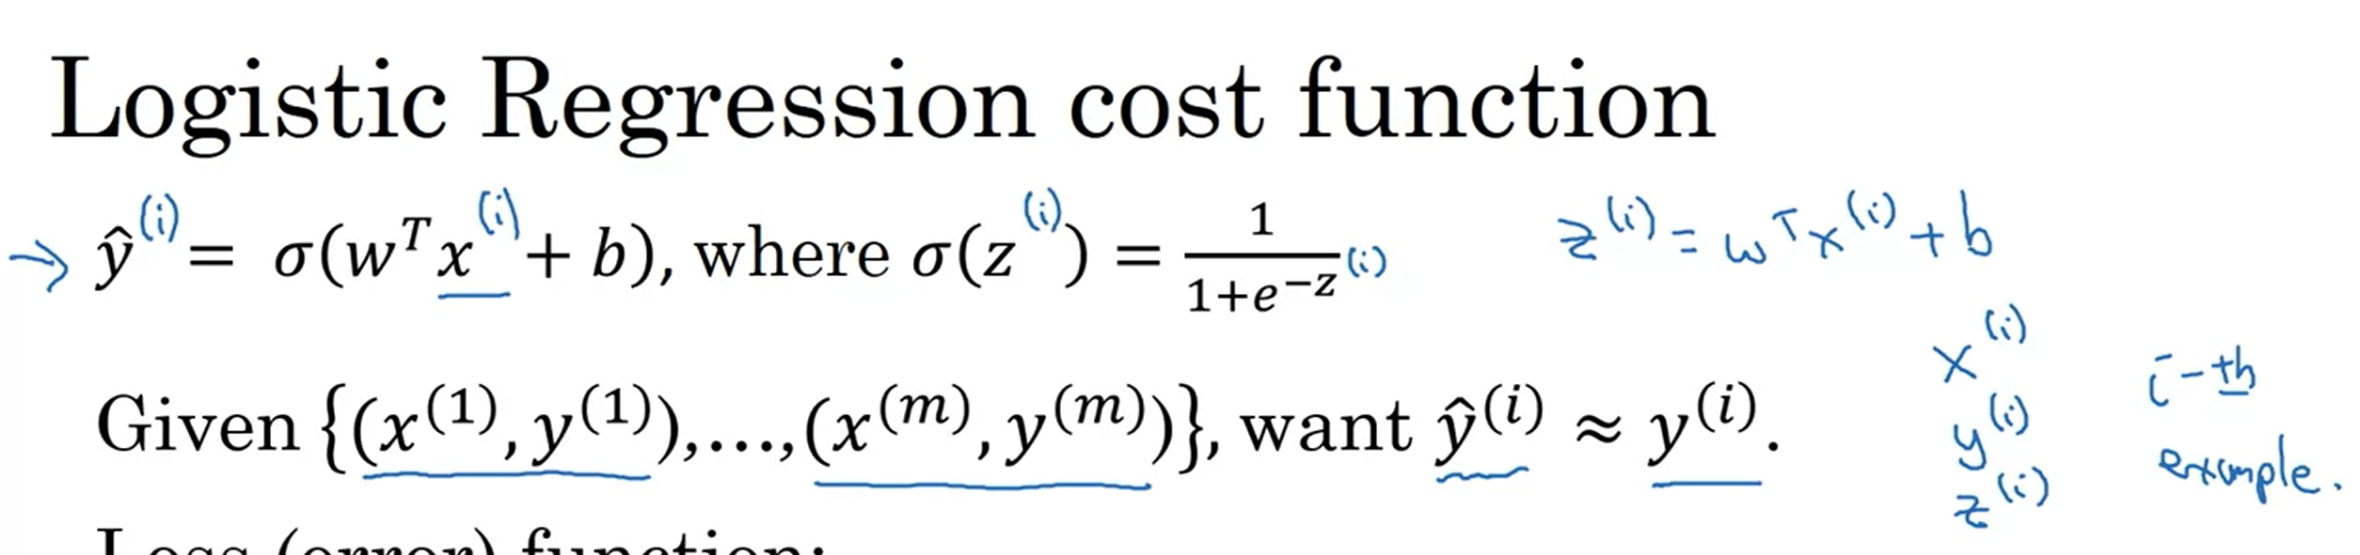
Logistic Regression Cost function - 1
Recap
We are given x values, we have a function to estimate Y ^
We want values which are closer to the original values.
We want to predict Y^ I for each Xi example.
Super script (i) shows data associated with ith example.

Slide 4

Logistic Regression Cost function - 2
Loss (error) function:
One way of defining loss is as shown below, however with this loss function the optimization problem of finding best weights & bias becomes non-convex with multiple optima, as a result, gradient descent will not be able to find global optima.
Squared error makes gradient descent not work.
That is why we don’t use this function.

Slide 5


Logistic Regression Loss function - 3
We want the loss function to be as small as possible. Let us look at 2 cases:
In case 1 y =1 , than the second term of the loss will become 0 as a result the loss will just the first term, which is –ylog(y_hat), to make the loss smaller, we want log(y_hat) to be large to make the loss smaller. To have log(y_hat) large therefore we would want to make y_hat large as well. We are doing this to make the loss as small as possible. In this case since the sign is negative therefore having the term with –ve sign large will make the loss smaller. Now when we are saying this that we want Y^ to be as large as possible it can only be larger as 1 in our case of binary classification, so we are in other words saying is that in case y =1 loss will be smallest when y ^ is largest which y ^ can be largest at 1. Voila. If y^ is 1 than its ln(1) will be 0.
In 2nd case, when y = 0 the first term will become 0, loss will be –log(1-y_hat), in this case if we want to decrease the loss value, we want log(1-y_hat) to be larger, for it to be largest y_hat has to be smallest and the smallest value y_hat can take is 0. Therefore, we are saying that the loss will be smallest when y =0 & y_hat = 0 which makes perfect sense.
Notes:
In a later video, we will have another justification for using this type of loss function.

Slide 6
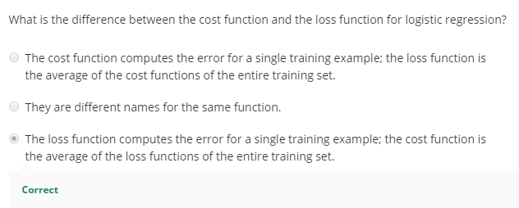
Logistic Regression Cost function
Previously we determined what is the loss on predicting one training example.
Here we determine the cost for determining on entire training set.
It will be the average of sum of loss function over all training examples In training, we determine the collective loss for all the examples as cost function.
The formula for cost function is shown in the right side.
Logistic regression can be viewed as a very small neural network.
Notes:
Cost function is overall for our parameters.
Logistic function can be viewed as a very small neural network.

Slide 7
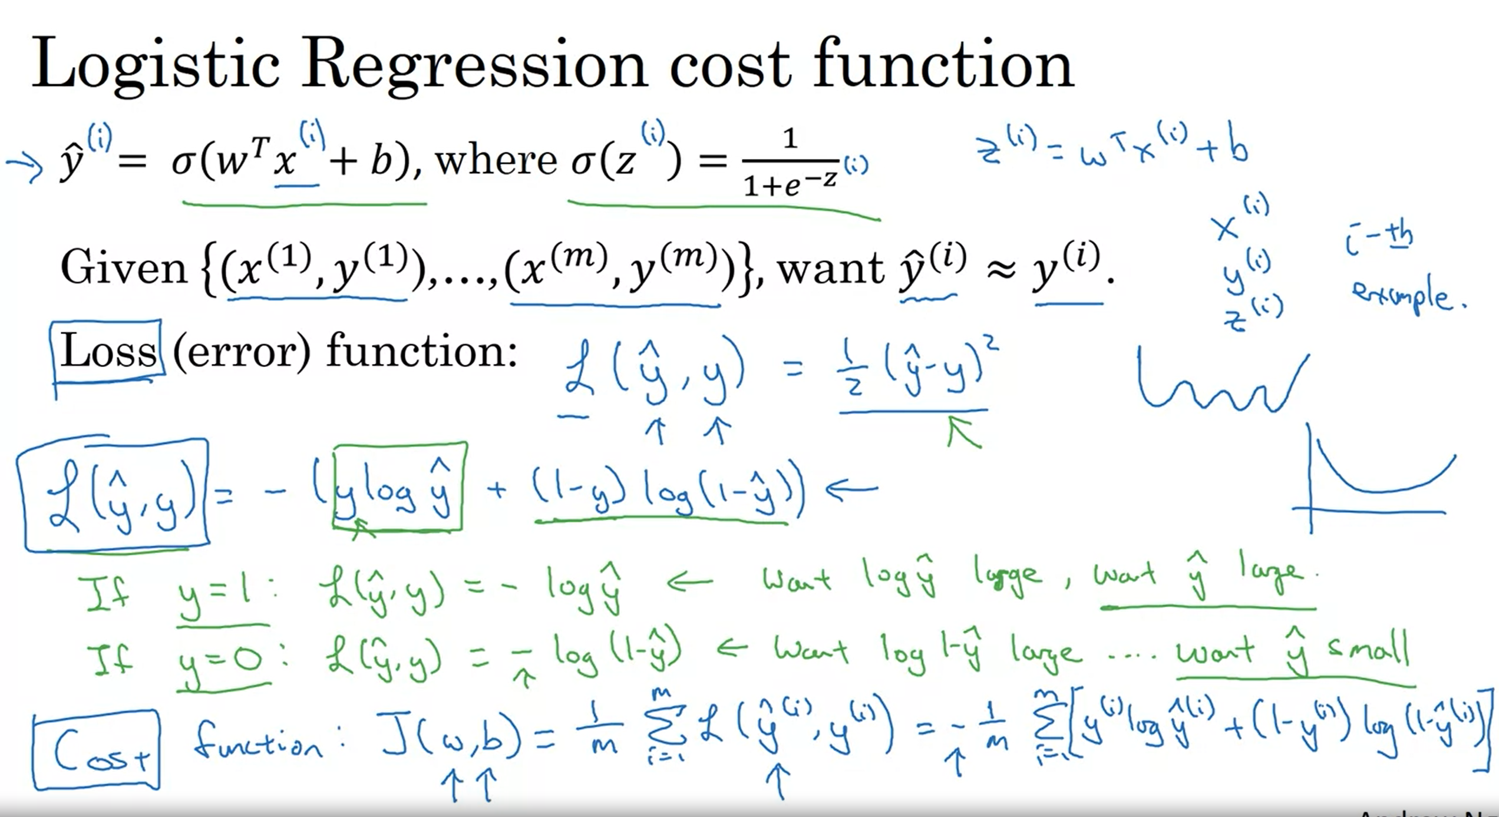
All in 1

